Slide 1
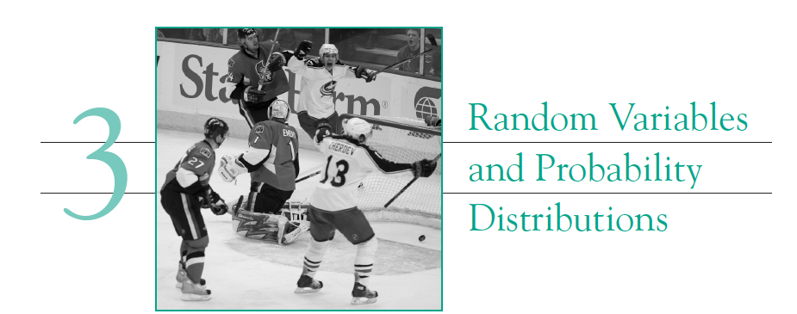

Slide 2
Random Variables
A variable whose measured value can change from one replicate of the experiment to another is referred to as a random variable.
Conductivity of glass from (seemingly) identical experiments.
Age of a randomly selected person in a grocery store.
Temperature of air at a given location on 1st January of every year at 10 am.

Slide 3
Should normally used variables be called non-random Variables?
Variable whose measured value can not change from one replicate of the experiment to another is referred to as a deterministic variable.
Mass of 1 L of water at a given temperature
Volume of one mol an ideal gas at a given temperature and pressure.
!!! Caution !!! : Variability is inherent in nature and all measurements has some degree of variability.

Slide 4
Discrete and continuous random variables
Discrete random variables can take values from a finite
Set of discrete numbers.
Continuous random variables can take any value in a
given range.
Number of text messages received in a day.
Number of accidents at an intersection.
The lifetime of a biomedical device after implant in a patient.
The strength of a concrete specimen.

Slide 5
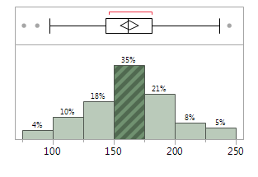
Probability distribution for random variables
Because of inherent randomness, it is not possible to assert the value of the random variables. But their probable range and probability distribution of their values may be known.
Example: We cannot predict exactly what will be the temperature of air outside tomorrow morning at 11 am, but we can say that “there is a very less probability that it will be 80 ºF”
Probability => Relative frequency.

Slide 6
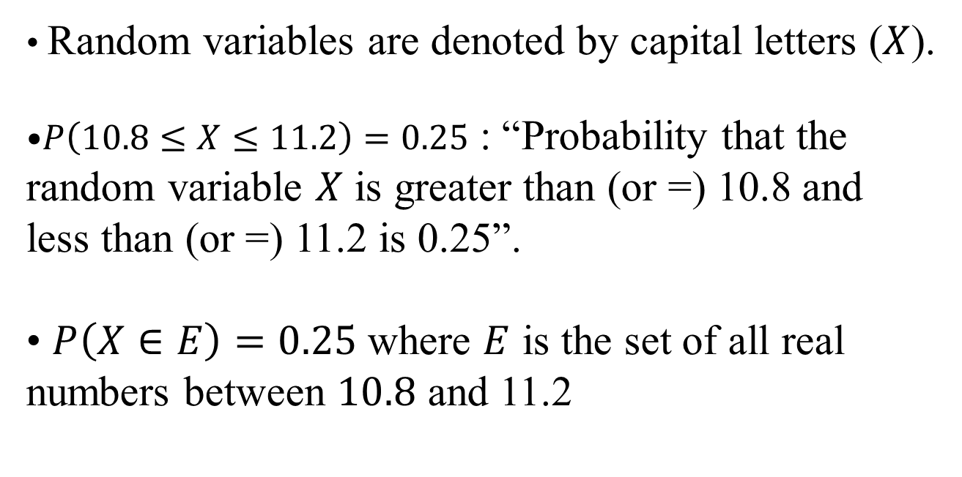
Probability: Notation
Random variables are denoted by capital letters ($X$).
$P\left(10.8≤X≤11.2\right)=0.25$ : “Probability that the random variable $X$ is greater than (or =) 10.8 and less than (or =) 11.2 is 0.25”.
$P\left(X∈E\right)=0.25$ where $E$ is the set of all real numbers between $10.8$ and 11.2
Is a continuous or a discrete random variable?

Slide 7
Terminology -1
Experiment/trials: The situation being considered.
Examples:
1. Drawing a card from a deck.
2. Conducting a glass preparation experiment.
3. Tossing a coin.
What are the random variables in each of the cases?
1. “the card drawn” is a random variable (X). Possible values of X are: Club, Diamond, Heart, Spade. (C, D, H and S). [Discrete or continuous?]
2. Measured value of conductivity.
Outcomes: Result of a single trial of an experiment.
A Diamond is drawn.
Head results in flipping of a coin.

Slide 8
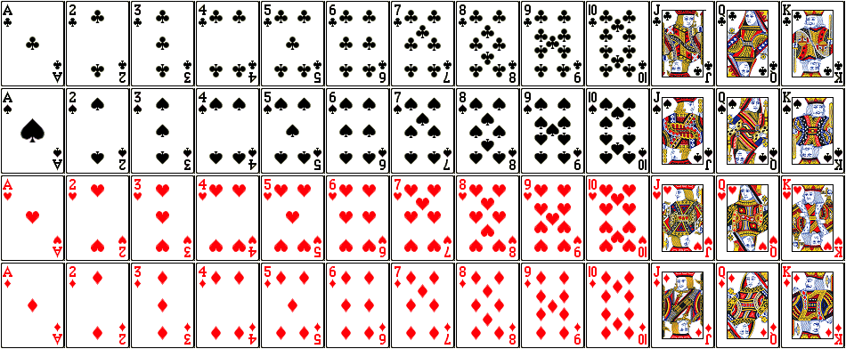

Slide 9
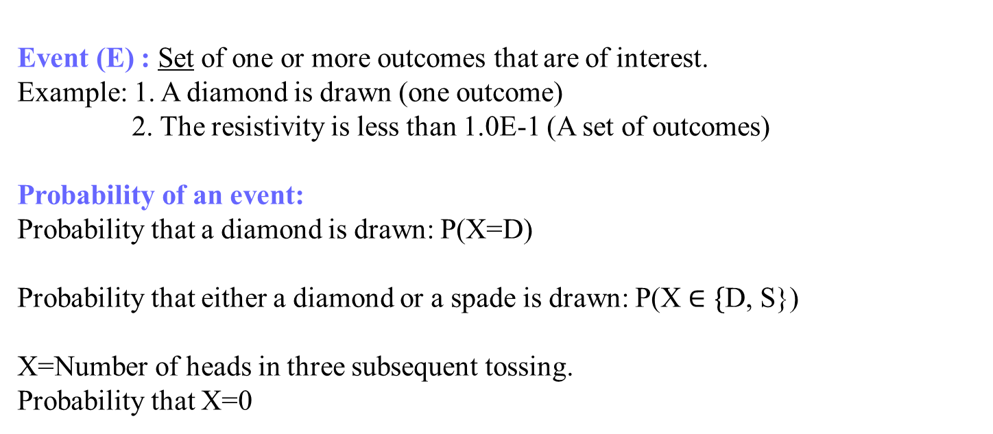
Terminology -2
Event (E) : Set of one or more outcomes that are of interest.
Example: 1. A diamond is drawn (one outcome)
2. The resistivity is less than 1.0E-1 (A set of outcomes)
Probability of an event:
Probability that a diamond is drawn: P(X=D)
Probability that either a diamond or a spade is drawn: P(X $∈\{$D, S})
X=Number of heads in three subsequent tossing.
Probability that X=0
Many of those probabilities can be determined by using
prior data or logical derivations.

Slide 10
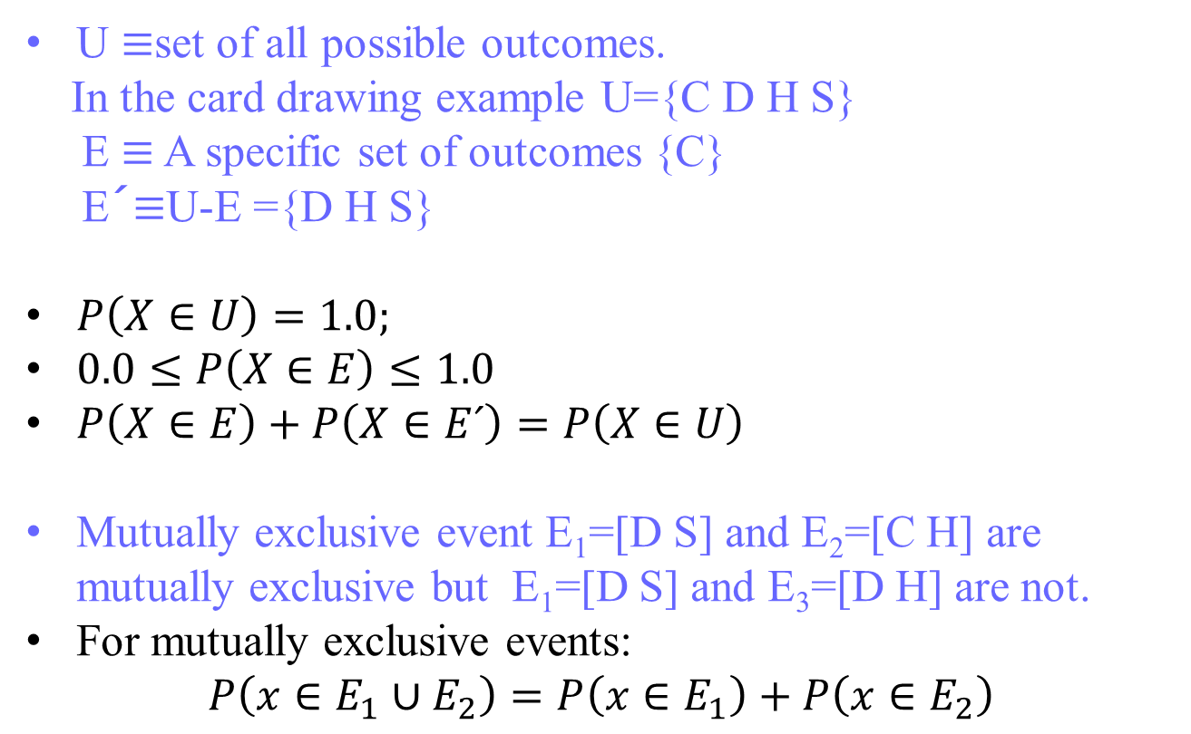
Probability Rules
U $≡$set of all possible outcomes.
In the card drawing example U={C D H S}
E $≡$ A specific set of outcomes {C}
E´$≡$U-E ={D H S}
$P\left(X∈U\right)=1.0;$
$0.0≤P\left(X∈E\right)≤1.0$
$P\left(X∈E\right)+P\left(X∈E´\right)=P\left(X∈U\right)$
Mutually exclusive event E₁=[D S] and E₂=[C H] are mutually exclusive but E₁=[D S] and E₃=[D H] are not.
For mutually exclusive events:
$$P\left(x∈E_{1}∪E_{2}\right)=P\left(x∈E_{1}\right)+P\left(x∈E_{2}\right)$$

Slide 11

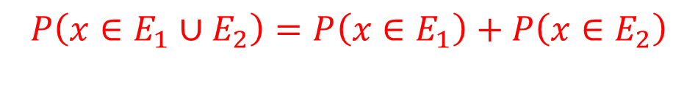
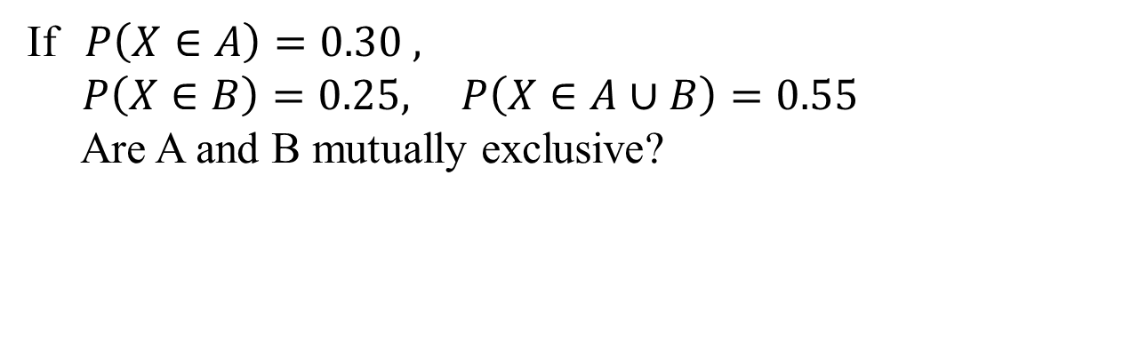
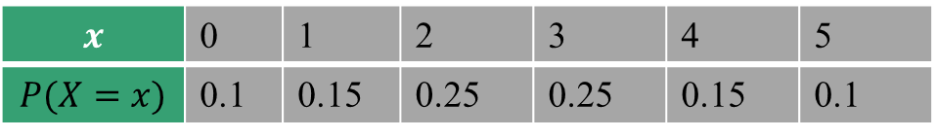
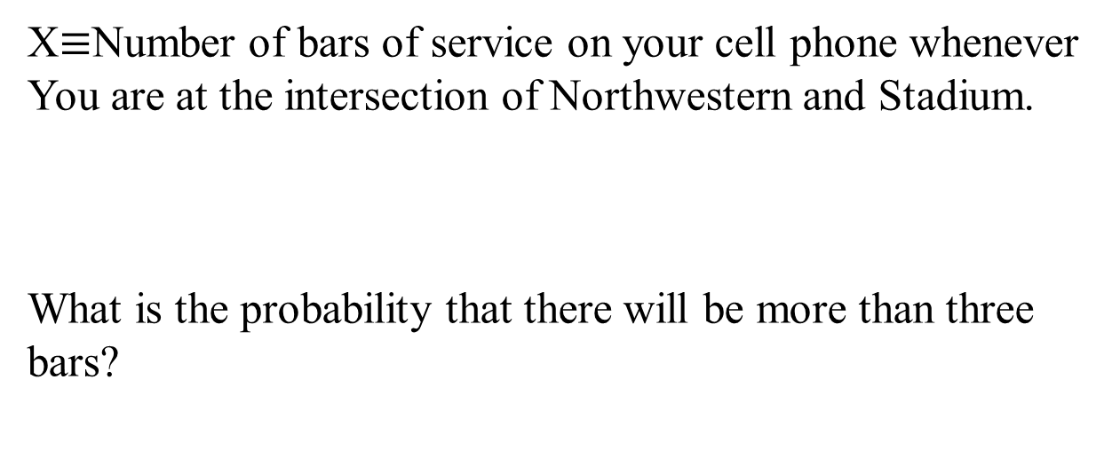
Using the ideas…
If$P\left(X∈A\right)=0.30 ,$
$P\left(X∈B\right)=0.25, P\left(X∈A∪B\right)=0.55$
Are A and B mutually exclusive?
$$P\left(x∈E_{1}∪E_{2}\right)=P\left(x∈E_{1}\right)+P\left(x∈E_{2}\right)$$
X$≡$Number of bars of service on your cell phone whenever
You are at the intersection of Northwestern and Stadium.
What is the probability that there will be more than three bars?
$$x$$ | 0 | 1 | 2 | 3 | 4 | 5
$$P(X=x)$$ | 0.1 | 0.15 | 0.25 | 0.25 | 0.15 | 0.1

Slide 12
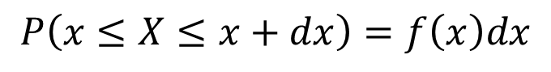
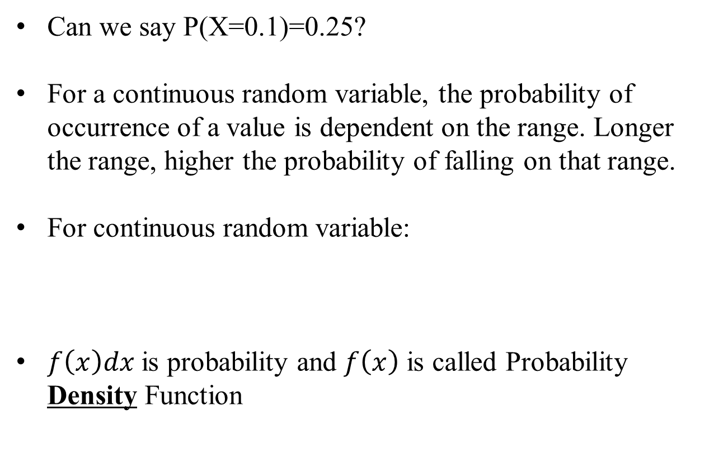
Probability distribution for
continuous random variable
Can we say P(X=0.1)=0.25?
For a continuous random variable, the probability of occurrence of a value is dependent on the range. Longer the range, higher the probability of falling on that range.
For continuous random variable:
$f\left(x\right)dx$ is probability and $f\left(x\right)$ is called Probability Density Function
$$P\left(x≤X≤x+dx\right)=f\left(x\right)dx$$

Slide 13
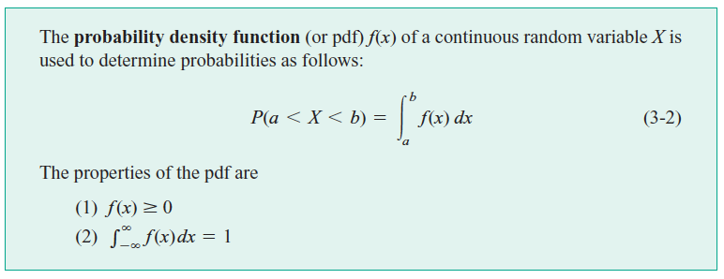
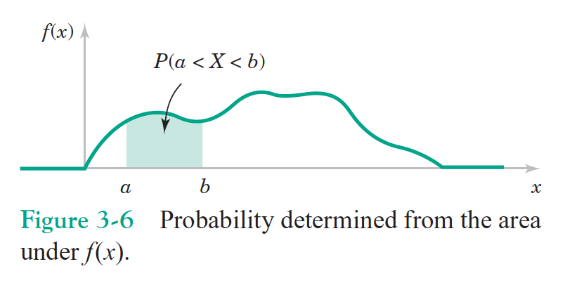
Probability Density Function (pdf)

Slide 14
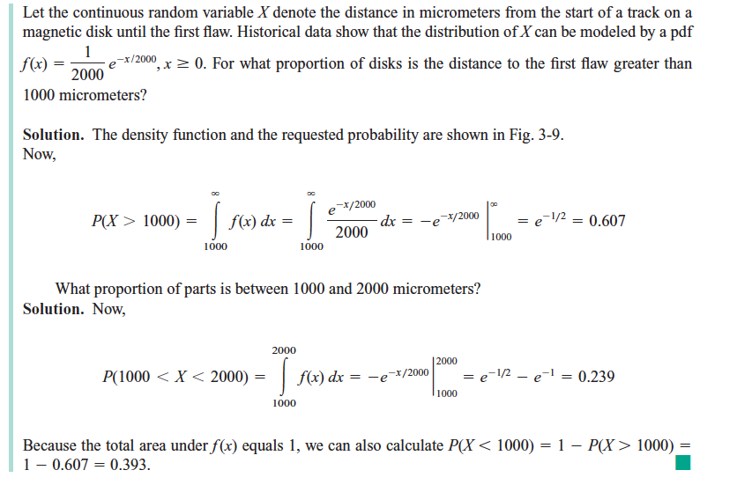
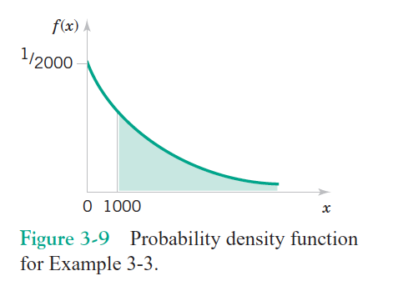

Using Probability Density Function
Remember: Probability$≡$Relative frequency

Slide 15
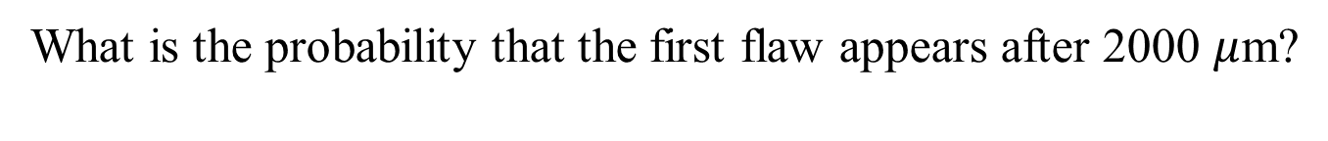
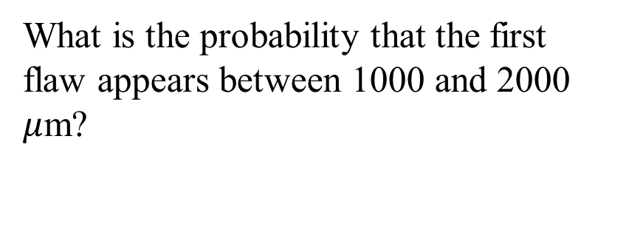
Using Probability Density Function
What is the probability that the first flaw appears after 2000 $μ$m?
What is the probability that the first flaw appears between 1000 and 2000 $μ$m?
2000

Slide 16
Using cumulative pdf
2000
cumulative of the pdf

Slide 17
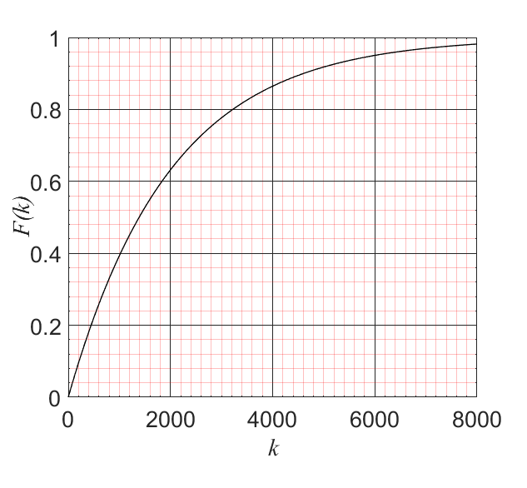
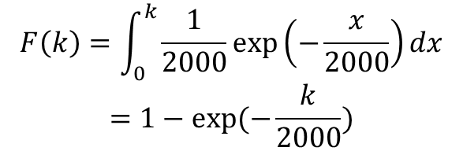
Cumulative probability density
$$F\left(k\right)=\int_{0}^{k}{\frac{1}{2000}\exp\left(−\frac{x}{2000}\right)dx}$$
$$=1−exp⁡(−\frac{k}{2000})$$

Slide 18
Cumulative probability density
$$F\left(k\right)=\int_{0}^{k}{\frac{1}{2000}\exp\left(−\frac{x}{2000}\right)dx}$$
$$=1−exp⁡(−\frac{k}{2000})$$

Slide 19
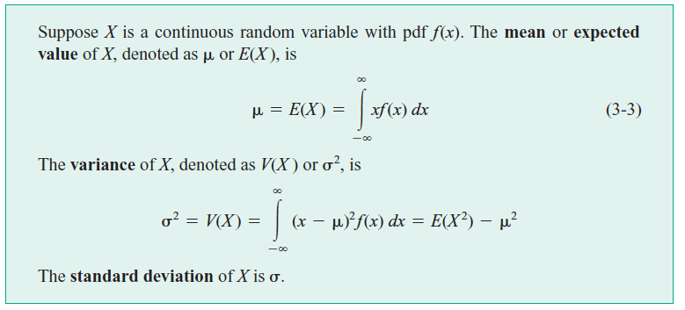
Mean (or Expected value) and Variance

Slide 20
Calculation of mean and variance

Slide 21
Normal /Gaussian Distribution
People’s height, errors in measurements, speed of automobiles
near exit 126 on I-65 north, Test scores, IQ score, amount of gas in the gas tank,……

Slide 22
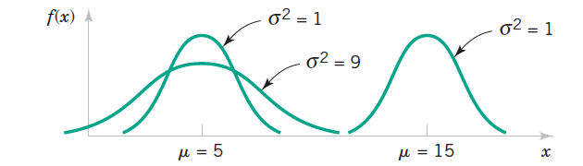

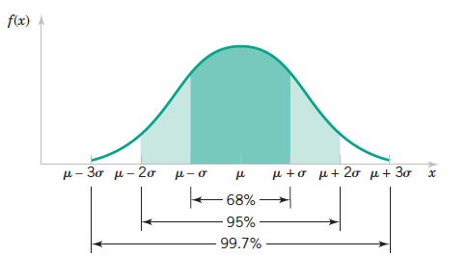
Normal Distribution: Features

Slide 23
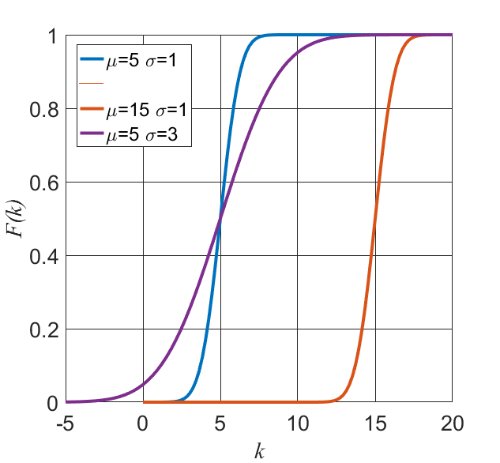
Normal Distribution: Cumulative

Slide 24
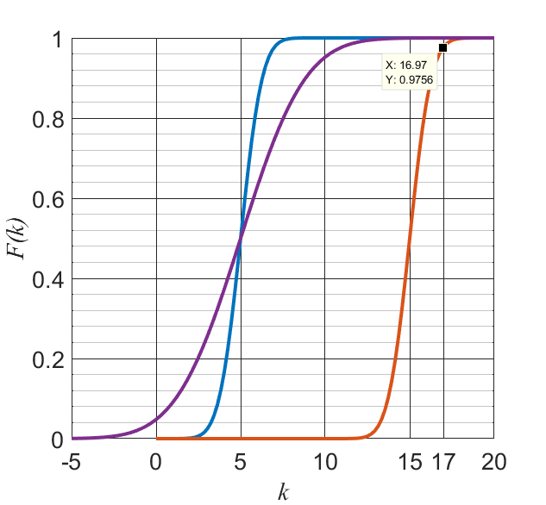
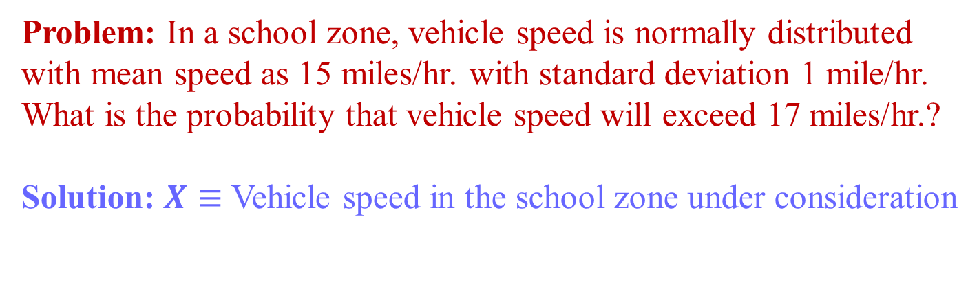
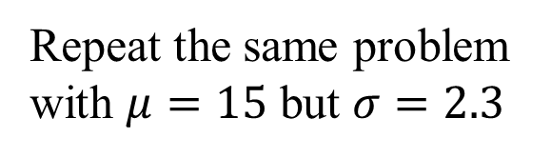
Normal Distribution: Cumulative
Problem: In a school zone, vehicle speed is normally distributed
with mean speed as 15 miles/hr. with standard deviation 1 mile/hr.
What is the probability that vehicle speed will exceed 17 miles/hr.?
Solution: $X≡$ Vehicle speed in the school zone under consideration
Repeat the same problem
with $μ=15$ but $σ=2.3$

Slide 25
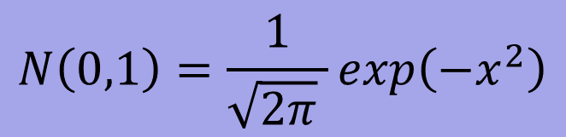
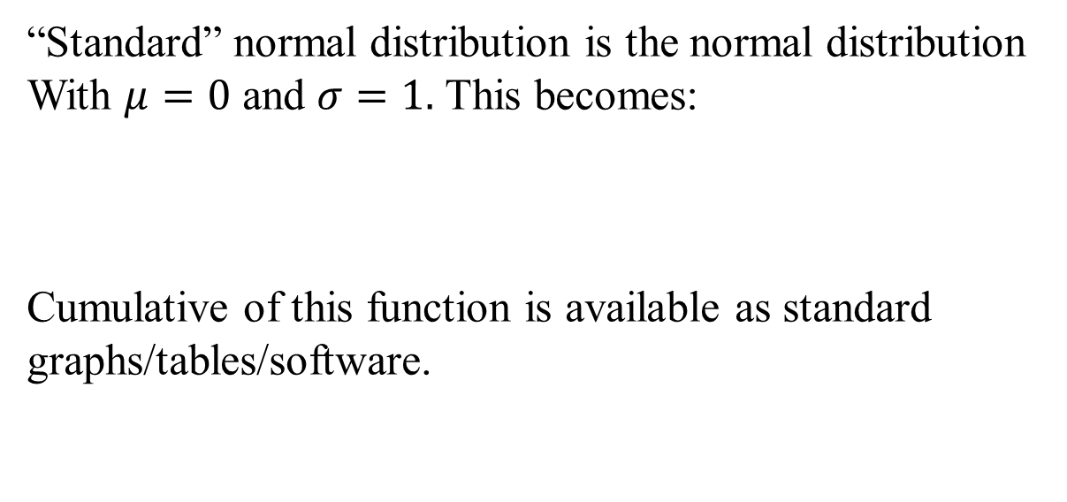
Standard Normal Distribution
“Standard” normal distribution is the normal distribution
With $μ=0$ and $σ=1.$ This becomes:
Cumulative of this function is available as standard graphs/tables/software.
$$N\left(0,1\right)=\frac{1}{\sqrt{2π} }exp\left(−x^{2}\right)$$

Slide 26
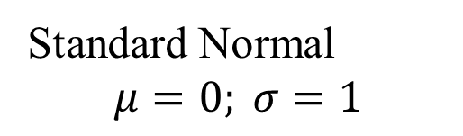
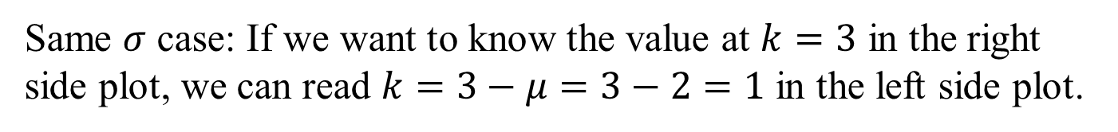
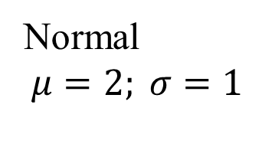
Using standard normal distribution:
Shifting
Standard Normal
$$μ=0; σ=1$$
Normal
$$μ=2; σ=1$$
Same $σ$ case: If we want to know the value at $k=3$ in the right
side plot, we can read $k=3−μ=3−2=1$ in the left side plot.

Slide 27
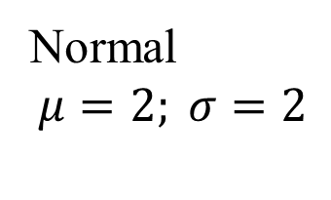
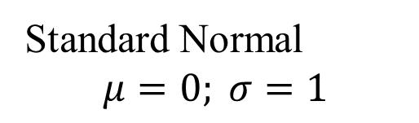
Using standard normal distribution:
Shifting and scaling
Standard Normal
$$μ=0; σ=1$$
Normal
$$μ=2; σ=2$$

Slide 28
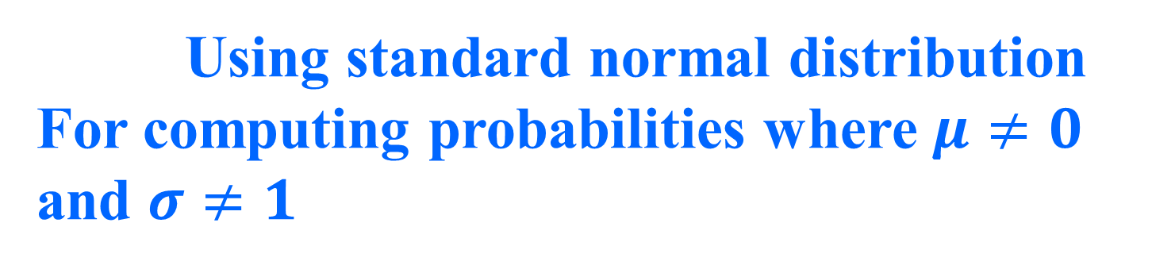


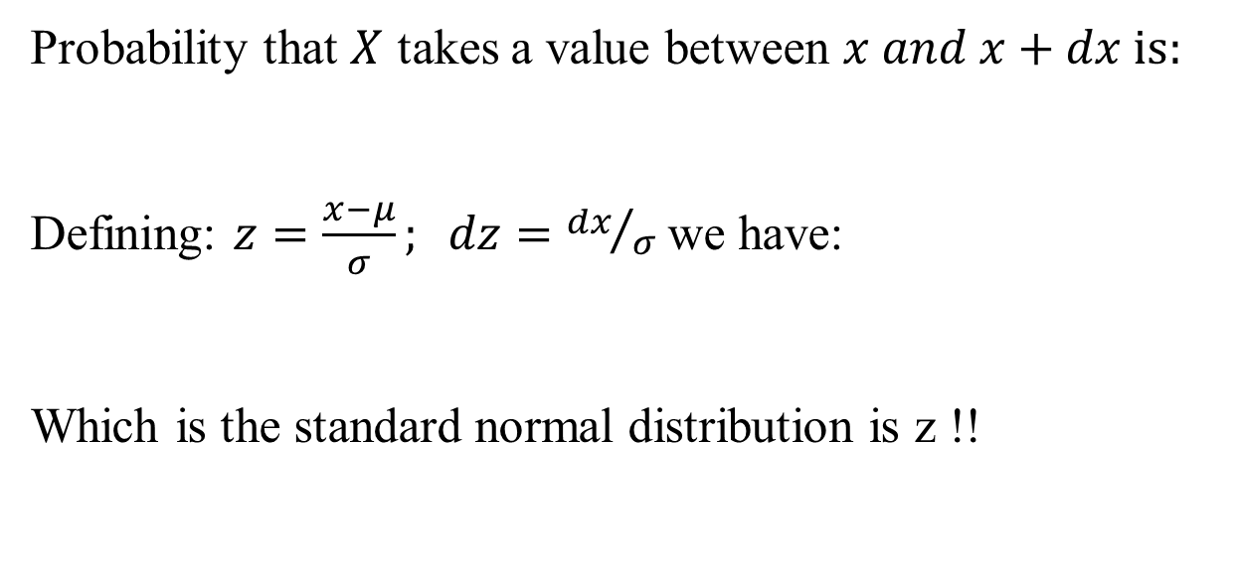
Using standard normal distribution
For computing probabilities where $μ≠0$ and $σ≠1$
Probability that $X$ takes a value between $x and x+dx is:$
Defining: $z=\frac{x−μ}{σ}; dz={dx}/σ$ we have:
Which is the standard normal distribution is z !!
$$N\left(μ,σ\right)dx=\frac{1}{\sqrt{2π} σ}exp\left(−\frac{{(x−μ)}^{2}}{σ^{2}}\right)dx$$
$$N\left(μ,σ\right)dx=\frac{1}{\sqrt{2π}}exp\left(−z^{2}\right)dz$$

Slide 29
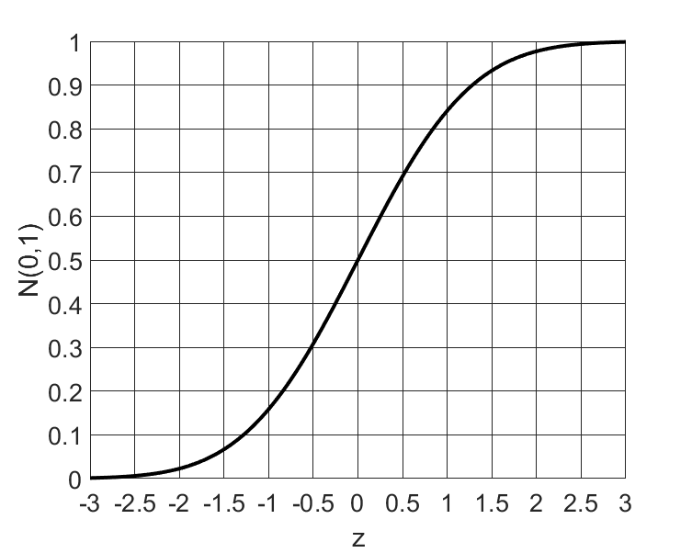
Using standard normal Distribution
Problem: In a school zone, vehicle speed is normally distributed
with mean speed as 15 miles/hr. with standard deviation 1 mile/hr.
What is the probability that vehicle speed will exceed 17 miles/hr.?
Solution:

Slide 30
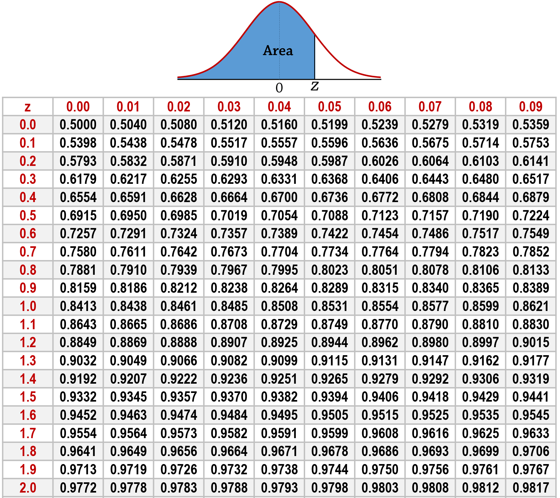

Slide 31
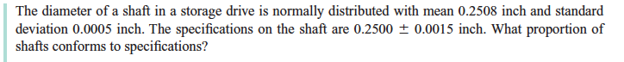
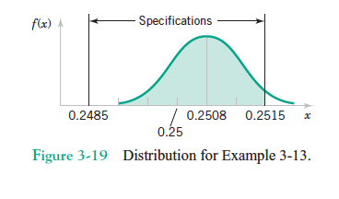
Example 3.13
We need to compute

Slide 32
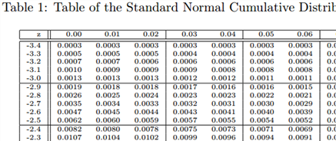

Slide 33
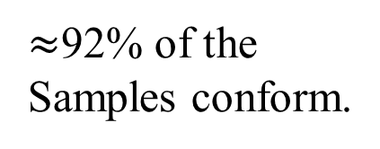
Example 3.13
$≈$92% of the
Samples conform.

Slide 35
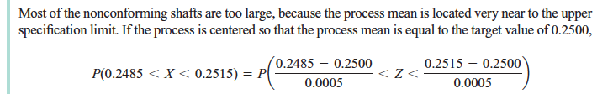
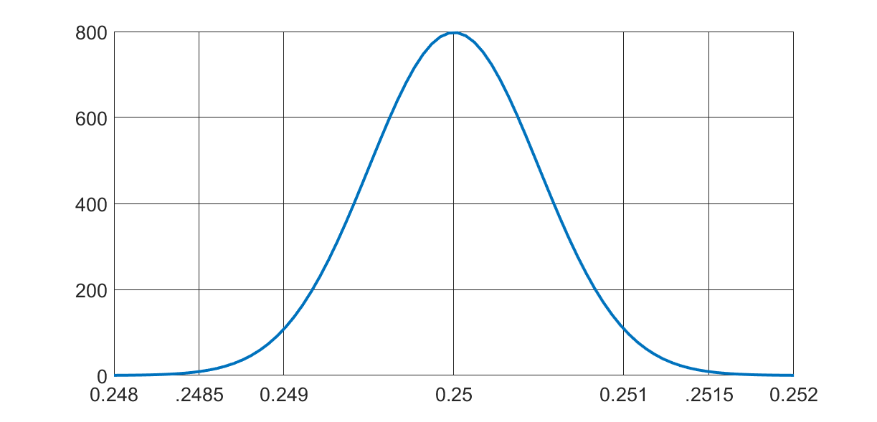
Example 3.13
what fraction of shafts confoms?
Specification

Slide 36
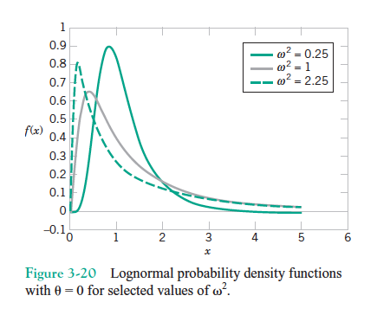
Other continuous probability distributions

Slide 37
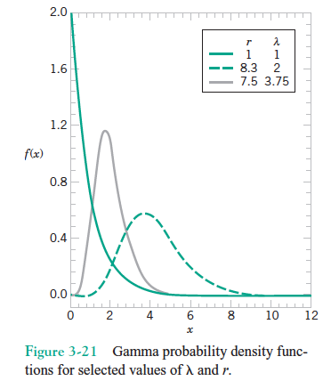
Other continuous probability distributions

Slide 38
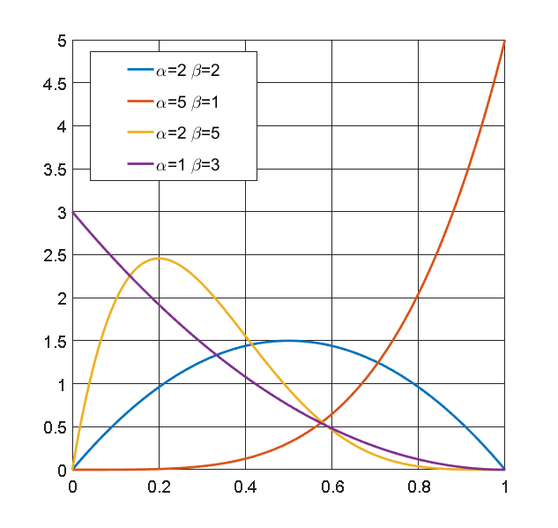
Other continuous probability distributions
Beta distribution

Slide 39
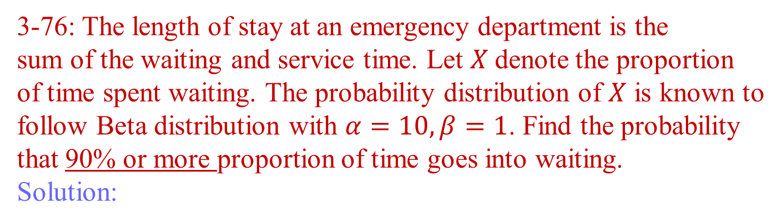
Using Beta distribution
3-76: The length of stay at an emergency department is the
sum of the waiting and service time. Let $X$denote the proportion
of time spent waiting. The probability distribution of $X$ is known to
follow Beta distribution with $α=10, β=1$. Find the probability
that 90% or more proportion of time goes into waiting.
Solution:

Slide 40
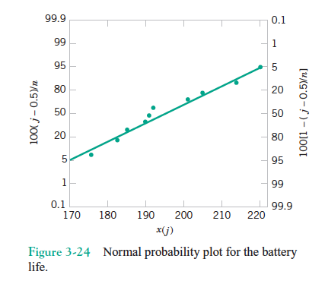
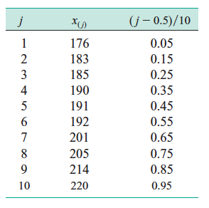
How do we know the distribution is normal?

Slide 41

Probability distribution for
discrete random variables
For the card drawing experiment:
P(X=C)=0.25;
P(X=D)=0.25;
P(X=H)=0.25;
P(X=S)= 0.25
The function $P\left(X=x_{i}\right)={f(x}_{i})$ is called probability mass function. In above: ${f(x}_{i})$ =0.25 for all $x_{i}$.
How will it change if Ace, King, Queen and Jack of Diamond are missing?

Slide 42

Common discrete pmf: Binomial Distribution
Experiment contains n repeated trials.
Examples: Flipping a fair coin 3 times.
Answering 10 multiple choice questions.
2. Each trial results in either “success” or “failure”
Head=Success Correct=Success
Tail=Failure Incorrect=Failure
3. Probability of success (and failure) remains constant from
trial to trial. P(H)=0.5, P(Correct)=0.25
The probability that among $n$ trials $x_{i}$will be success is given by:

Slide 43

Binomial Distribution: Plots

Slide 44

Example: Binomial Distribution
3. 106: A product contains 40 IC. The probability that an IC is
defective is 0.01. The product operates when there are no defective
ICs. What is the probability that the product operates?
$X≡$ The number of functional ICs in the product.
40 trials involve picking up each of the 40 ICs randomly.
Success$≡$IC not defective. Probability: 0.99
Failure $≡$ IC defective.
$∴X$ must have binomial distribution.
P(The machine operates)=P(40 success out of 40 trials)

Slide 45



Poisson Process
Consider arrival of messages in your mailbox. We do not conduct
“trials”. We do not have a notion of “either of the two outcomes”.
Rather, events occur at random in an interval. Such a process is
called Poisson Process.
$X≡\#$ of events in a given interval.
And if the average number of events in the interval$(λ)$ is known,
the probability that $x_{i}$ number of events will occur in the interval
is given by:

Slide 46


Poisson Process: Example
3-124: In an earthquake prone area, on an average 6 earthquakes are
observed per year. What is the probability that there will be 10
tremors in a year?
Solution: The process is a Poisson process. In this case
The probability of 10 ( $x_{i}=10$, $λ=6$) tremors is given by:
$X1≡\#$ of events in a given interval. (Discrete random variable)
$X2≡$ Time between two successive events for the same process. (Continuous random variable)

Slide 47



From Poisson to exponential
$X_{2}=x$ unit of time;
Average rate of process $λ$/unit time
$∴ λx=$ Avg. number of events in $x$ unit time.
IQ
Time
$$x$$
Number of events in a given interval=0
Time between two successive events (IQ) $>x$

Slide 48

From Poisson to exponential
$X_{2}=x$ unit of time;
Average rate of process $λ$/unit time
$∴ λx=$ Avg. number of events in $x$ unit time.
IQ
Time
$$x$$
Number of events in a given interval$≠$0
Time between two successive events (IQ) $<x$

Slide 49

From Poisson to exponential
$X_{2}=x$ unit of time;
Average rate of process $λ$/unit time
$∴ λx=$ Avg. number of events in $x$ unit time.
IQ
Time
$$x$$
Number of events in a given interval=0
Time between two successive events $(IQ)>x$

Slide 50
From Poisson to exponential
$X_{2}=x$ unit of time;
Average rate of process $λ$/unit time
$∴ λx=$ Avg. number of events in $x$ unit time.
IQ
Time
$$x$$
Number of events in a given interval=0
Time between two successive events $(IQ)>x$

Slide 51

From Poisson to exponential
$X_{2}=x$ unit of time;
Average rate of process $λ$/unit time
$∴ λx=$ Avg. number of events in $x$ unit time.
IQ
Time
$$x$$
Number of events in a given interval $≠$0
Time between two successive events $<x$

Slide 52
From Poisson to exponential
$X_{2}=x$ unit of time;
Average rate of process $λ$/unit time
$∴ λx=$ Avg. number of events in $x$ unit time.
IQ
Time
$$x$$
Number of events in a given interval=0
Time between two successive events (IQ) $>x$

Slide 53

From Poisson to exponential
$P\left(X_{1}=0\right)≡P(X_{2}>x)$

Slide 54


From Poisson to exponential
$X_{2}=x$ unit of time; Average rate of process $λ$/unit time
$∴ λx=$ Avg. number of events in $x$ unit time.
$P\left(X_{1}=0\right)≡P(X_{2}>x)$
Time
$$x$$

Slide 55

Exponential distribution
$X≡$ Time between two successive events for Poisson process is
distributed according to
In an earthquake prone area, on an average 6 earthquakes are
observed per year. What is the probability that there will be no
tremors at least for a month?
Time between two successive tremors is a random variable $X.$
$∴$P(No earthquake in a month)=

Slide 56

Expected value (mean, $μ)$for discrete distribution (Poisson dist.)

Slide 57



Mathematics and abstraction…
Images from Google Images

Slide 58


Arrival in time vs. arrival in length…
Time
$$x$$
Length
$$x$$

Slide 59


Arrival in length…
3-125: Number of cracks in a section of interstate highway assumed to
Follow Poisson distribution with 2 cracks/mile. What is the probability
That there are no cracks in 5 miles?
Length
$5$ miles
Average number of cracks in 5 miles is 10. $∴ λ=10, x_{i}=0$
$$P\left(x_{i}=0\right)={e^{−10}{10}^{0}}/{0!}=4.5×{10}^{−5}$$

Slide 60
Poisson distribution

Slide 61

Probability distribution for more than one random variable
So far we asked and answered the following question: “What is the probability (or probability density) that the random variable $X$ takes the value $x$ (or from $x$ to $x+dx$)?”
Now we look into the question: “What is the probability that the random variable $X$ takes the value $x$ (or from $x$ to $x+dx$) and the random variable $Y$ takes the value $y$ (or from $y$ to $y+dy$)?”
Examples:
Yearly rainfall ($X)$ and crop production ($Y).$
Length ($X)$ and diameter ($Y)$of a cylindrical bacterium.

Slide 62

Joint Distributions

Slide 63
Independence
Joint probability density function: $f\left(x,y\right)dxdy=f\left(x\right)dx×f\left(y\right)dy$
Joint probability mass function: $f{(x}_{i},y_{i}) =$ $f{(x}_{i})$ $f{(y}_{i})$

Slide 64

Independence
Trials: Balls are picked blindfolded and replaced
$X≡$ Color of the first ball picked
Y$≡$ Color of the second ball picked
$$P\left(X=R \& Y=B\right)=?$$
$P\left(X=R \& Y=B\right)=P\left(X=R\right)×P\left(Y=B\right)$=0.5$×0.5=0.25$

Slide 65


Joint probability distribution: Example
3-171: A grocery store tracks the joint distribution of the number of
Apples and oranges in each customer transaction. Let $X$ and $Y$ denote
The number of apples and oranges, respectively, and assume the
Following joint distribution.
Obtain:
a) P($X=6, Y=6)$ b) whether or not $X$ and $Y$ are independent.
Y X | 0 | 6 | 12
0 | 0.50 | 0.05 | 0.10
6 | 0.05 | 0.10 | 0.05
12 | 0.10 | 0.05 | 0.00
Answer: a) 0.10 b) $0.2×0.2=0.04≠0.10$

Slide 66
Discrete joint probability distribution

Slide 67
Applications in system analysis
0.90
0.90
0.95
0.95
P(at least one operates)=1-P(both fails)=1-(1-.9)(1-.95)=.995

Slide 68

Functions of Random Variables
Example: Reactor yield (one random variable) is a function of
temperature (another random variable). While the relation
between these two random variable might be complex, often there
exists simple functional relation between random variables.
Temperature in K and temperature in ºC:

Slide 69

Translation vs stretching

Slide 70



Linear Functions
Diameter and radius:
Linear Function:

Slide 71

Functions of Random Variables: Example
3-175: If $X_{1}$and $X_{2}$are independent random variables with:
and $Y=4X_{1}−2X_{2}$, determine $E\left(Y\right), V\left(Y\right), E\left(2Y\right), V(2Y).$
Answers: 22, 128, 44, 512

Slide 72

Non-Linear functions
Non-linear Function:
Y=Electrical conductivity of a semiconductor sample
X₁=Carrier concentration
X₂$=$Carrier mobility.
$$Y=X_{1}×X_{2}$$
Carrier concentration and mobility are two independent random variables.
Electrical Conductivity is the property of practical interest.
If the mean and variance of carrier concentration and mobility are known,
what are the mean and variance of electrical conductivity?

Slide 73

Non-Linear functions

Slide 74

Functions of Random Variables: Example
3-190:
If $X_{1}$ and $X_{2}$ are independent random variables with $E\left(X_{1}\right)=2$,
$E\left(X_{2}\right)=5$, V$\left(X_{1}\right)=2$, V$\left(X_{2}\right)=10$, and Y$=X_{1}X_{2}.$ Compute
the mean and variance of Y
Solution:
Propagation of error

Slide 75
Functions of Random Variables
Independent random variables
Linear functions
Non-linear functions
Dependent random variables
Linear functions
Non-linear functions (?)

Slide 76

Function of dependent random Variables
$Y=X_{1}+X_{2}$ ; $X_{1}, X_{2}$ are dependent random variables
$$E\left(Y\right)=E\left(X_{1}+X_{2}\right)=E\left(X_{1}\right)+E(X_{2})$$
Additional Formulae required:

Slide 77
Sample correlation coefficient
$$x↑y↑$$
$$x>\overline{x} y>\overline{y}$$
$$x−\overline{x}>0 y−\overline{y}>0$$
$$(x−\overline{x})(y−\overline{y})>0$$
$x↓y$ $↓$
$$x<\overline{x} y<\overline{y}$$
$$x−\overline{x}<0 y−\overline{y}<0$$
$$(x−\overline{x})(y−\overline{y})>0$$
If values of $y$ $increases or decreases with the values of x$, the product
$(x−\overline{x})(y−\overline{y})$ is positive. Otherwise, the product is negative.
If all (or most) data points show such feature, the sum
$$S_{xy}≡\sum{(x_{i}−\overline{x})(y_{i}−\overline{y})}$$
Will have higher value.

Slide 78


Covariance and Correlation coefficient
Sample correlation coefficient: $r={S_{xy}}/{\sqrt{S_{xx}S_{yy}}}$
Correlation coefficient: $ρ_{X_{1}X_{2}}=\frac{Cov(X_{1}X_{2})}{σ_{1}σ_{2}}$

Slide 79

Random Samples
$X_{1}≡$ First observation
$X_{2}≡$ Second observation
$X_{3}≡$ Third observation
Independent random variables with the same distribution
Are called random samples.

Slide 80

Statistic
Example: Sample mean $\overline{X }$.
Sample mean of n random variables is defined as:

Slide 81

Mean and variance of sample mean
Sample mean of n random variables is defined as:
The expected value of each of the random variable is $μ$
and hence:
Sample mean is also a random variable

Slide 82
Sampling distribution
2000

Slide 83

Central Limit Theorem
If we are sampling from a population that has an unknown
probability distribution whose mean is $μ$ and variance is
$σ$, the probability distribution of the sample mean ($\overline{X})$ is
approximately normal with mean $μ$ and variance $\frac{σ^{2}}{n}.$

Slide 84



Distribution of $X$ vs. its sampling distribution
$$μ=2000;σ=2828$$
Exponential decay
Sample mean is obtained
with 40 observations.
$$μ=2000;$$
$$σ=\frac{2828}{\sqrt{40}}=447$$
Normal distribution

Slide 85


Central Limit Theorem: Example
$ΔT$ is random variable with $μ=20$ s and
$σ=0.5 s$. 40 such experiments have been
carried out.
What is the probability that the average
obtained from those 40 experiments will
exceed 20.1 s?

Slide 86
Central Limit Theorem: distributions

Slide 87



Central Limit Theorem: Example
Assume a sample of 40 observations is drawn from a population
with mean 20 and variance 2. Compute:
Mean and variance of $\overline{X}$ and plot the pdf for $\overline{X}$
b)
$E\left(\overline{X}\right)=μ$ and
$V\left(\overline{X}\right)=σ^{2}/n$.
We also know, according to Central limit theorem,
$\overline{X}$ is normally distributed.
$n=40;$
$E\left(\overline{X}\right)=μ=20$ and
$V\left(\overline{X}\right)=\frac{2}{40}=\frac{1}{20}⇒σ=0.2236$.

Slide 88


Distribution of $\overline{X}$

